Slide 1

DEPARTMENT OF COMPUTER APPLICATION UNIVERSITY INSTITUTE OF TECHNOLOGY RAJIV GANDHI PROUDYOGIKI VISWAVIDYALAYA
A MAJOR PROJECT PRESENTATION
ON
Face Mask Detection
Submitted To : Submitted By:
MR Jay Narayan Thakre Shreeya Shrivastava

Slide 2


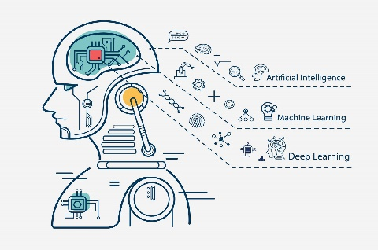
FACE MASK DETECTION

Slide 3
INTRODUCTION :-
Corona Virus was originated in Wuhan, China at the end of 2019. Since then, it had been spreading like a wild fire in a forest.
To tackle this virus one of the major role players is a “Face Mask” which protects us from being infected.
Putting a face mask on can reduce the risk of getting infected by a great extent, not only to the one wearing it but also to the others that he/she comes in contact with.
In this presentation, I propose a “Face Mask Detection Project” which detects whether a person is wearing a mask or not.

Slide 4
OBJECTIVE :
To create a face mask detection model so as to recognize whether a person is wearing a mask or not AND generate a notification if not wearing a mask.

Slide 5
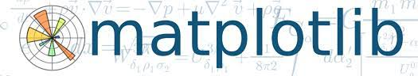
LIBRARIES & MODULES USED :
Matplotlib is a comprehensive library for creating static, animated, and interactive visualizations in Python.
Matplotlib is an amazing visualization library in Python for 2D plots of arrays.
Matplotlib comes with a wide variety of plots. Plots helps to understand trends, patterns, and to make correlations

Slide 6
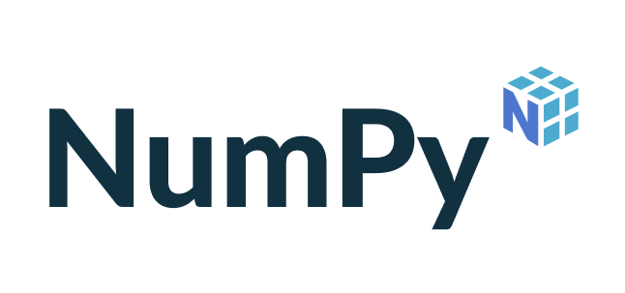
NumPy is general purpose array processing package.
NumPy stands for Numerical Python.
NumPy aims to provide an array object that is up to 50x faster than traditional Python lists.
The array object in NumPy is called ndarray, it provides a lot of supporting functions that make working with ndarray very easy.

Slide 7

OpenCV is the huge open-source library for the computer vision, machine learning, and image processing.
By using it, one can process images and videos to identify objects, faces, or even handwriting of a human.
When it integrated with various libraries, such as NumPy, python is capable of processing the OpenCV array structure for analysis.
To Identify image pattern and its various features we use vector space and perform mathematical operations on these features.

Slide 8

Keras is an open-source high-level Neural Network library, which is written in Python is capable enough to run on Theano, TensorFlow, or CNTK.
It was developed by one of the Google engineers, Francois Chollet.
It is made user-friendly, extensible, and modular for facilitating faster experimentation with deep neural networks.
It not only supports Convolutional Networks and Recurrent Networks individually but also their combination.

Slide 9
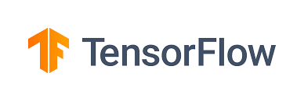
TensorFlow is an end-to-end open-source machine learning platform with a focus on deep neural networks. Deep learning is a subtype of machine learning that analyses massive amounts of unstructured data. Since it works with structured data, deep learning is different from normal machine learning.
TensorFlow provides a diverse and complete set of libraries, tools, and community resources. It allows developers to create and deploy state-of-the-art machine learning-powered applications.
The TensorFlow Python deep-learning library was first created for internal use by the Google Brain team. Since then, the open-source platform’s use in R&D and production systems have risen.

Slide 10
WORKING OF THE MODEL :
Data Preprocessing
CNN Model Training
Applying a Face Mask Detector

Slide 11
Data preprocessing :
Loading the images and mounting the drive.
Converting the images into grayscale (since grayscale has only one channel and they are easier for computation)
Normalising the images using np.array(image). Normalising means converting images into similar scale.
Our date is labeled as “with_mask” and “without_mask” , computer works only with numbers. Using “One Hot Encoding” we convert the images into specific labels.
After applying labels we divide the data into training (75%) and testing test (25%).

Slide 12
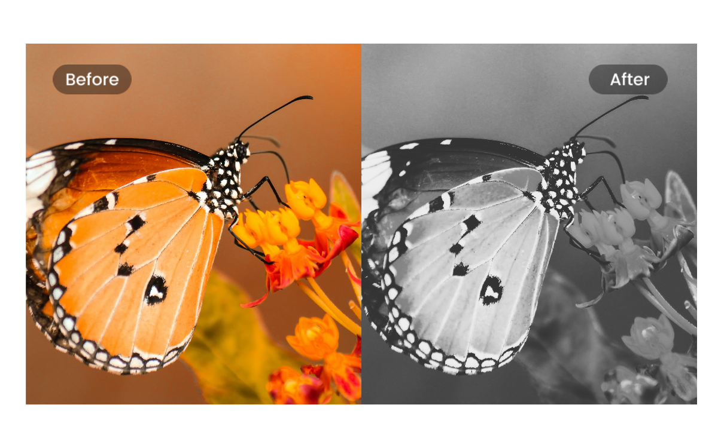

Slide 13
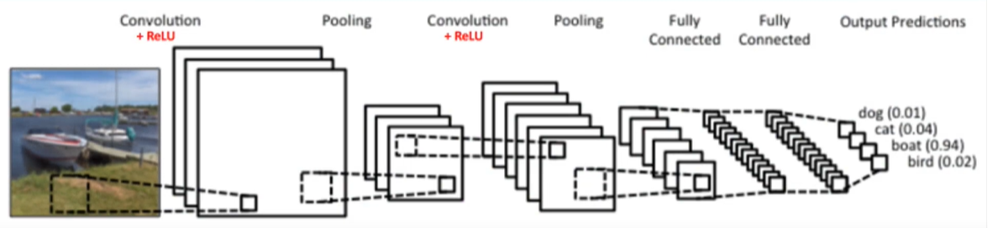
Convolution neural Network
What is CNN ???
CNN (Convolutional Neural Network) are neural networks which are primarily used to classify images , detect objects , recognize features etc.
CNN is a network of processing layers used to reduce an image into its key features so that it can be easily classified.

Slide 14
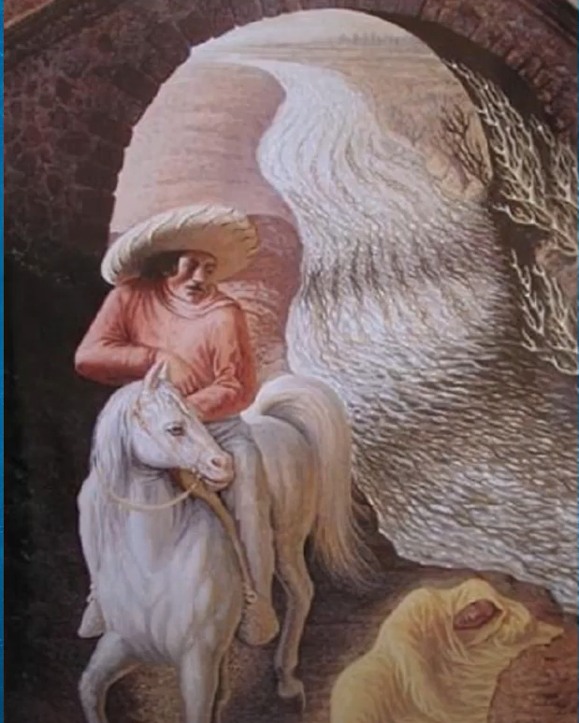
For Eg : In this image some of you might see a person sitting on a horse and others might see an old man, your brain is trying to process this image by looking at features and come to a conclusion.

Slide 15
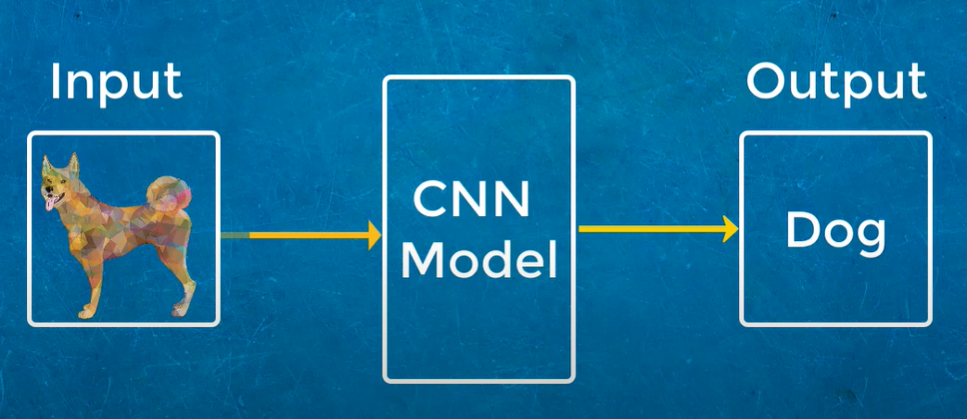
Similarly our computer tries to process any image using the CNN model. Here we give images of cats & dogs and our CNN Model will classify them into a category.

Slide 16
So how Our CNN Model Classifies an image ??
Consider u have two images one of black & white image of 2x2 pixel and other is colored image of 2x2 pixel.
Black & white image is referred as 2D image
Colored Image is referred as 3D image
Each of the pixel in black & white image is a 8bit information that is every
pixel having value of 0 and 255 which is including 0 is total 256 so 1-255 and 0 so it will make 256.

Slide 17
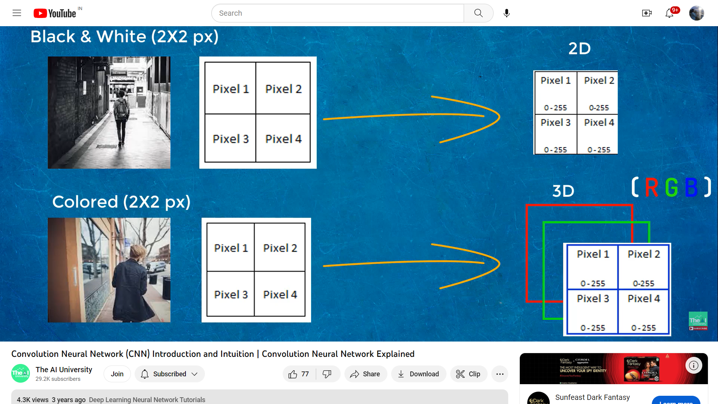
Now 2^8 = 256 only and that’s why 8 bit of information . 0-255 is the intensity of colour where 255 is completely white pixel and 0 is completely black pixel.
And in between you will have grayscale range of colors to start with computers read this information to process the image . So every image is representation of 0s & 1s.

Slide 18
Colored images are made up of 3 – channels RED , BLUE , GREEN (RGB)
So basically three layers each of red , blue , green now each of them have their own color intensities therefore 0-255 . Computers combine these separate colors to find out the color of the image.

Slide 19
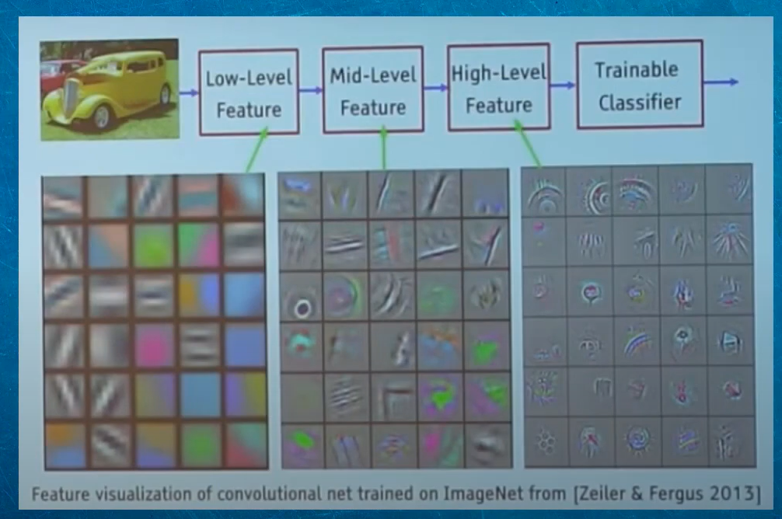
This is how computer sees different features of an image .To understand these features of an image CNN uses different layers like Convolution , Max Pooling , Flattening etc

Slide 20
1) Convolution layer
Convolution Operation is a mathematical operation that allows merging of two sets of information.
In the case of CNN, convolution is applied to the input data to filter the information and produce a feature map.
This filter is also called a kernel, or feature detector, and its dimensions can be, for example, 3x3.
To perform convolution, the kernel goes over the input image, doing matrix multiplication element after element. The result for each receptive field (the area where convolution takes place) is written down in the feature map.
STRIDE : The step at which we move feature detector is called stride.
here Stride = 1

Slide 21
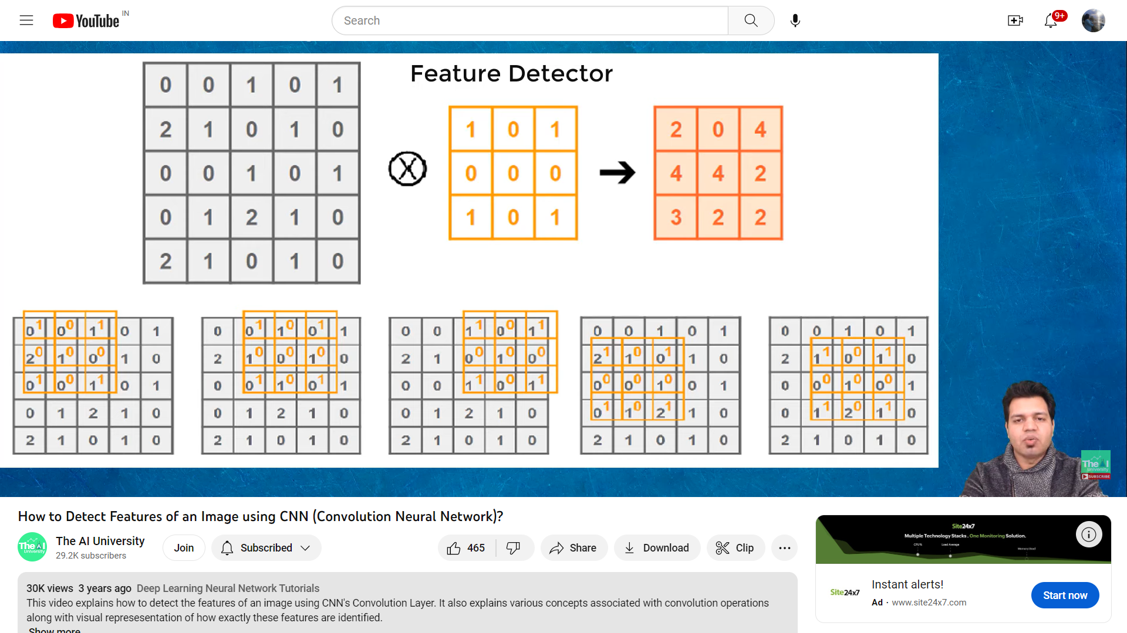
Feature MAP

Slide 22
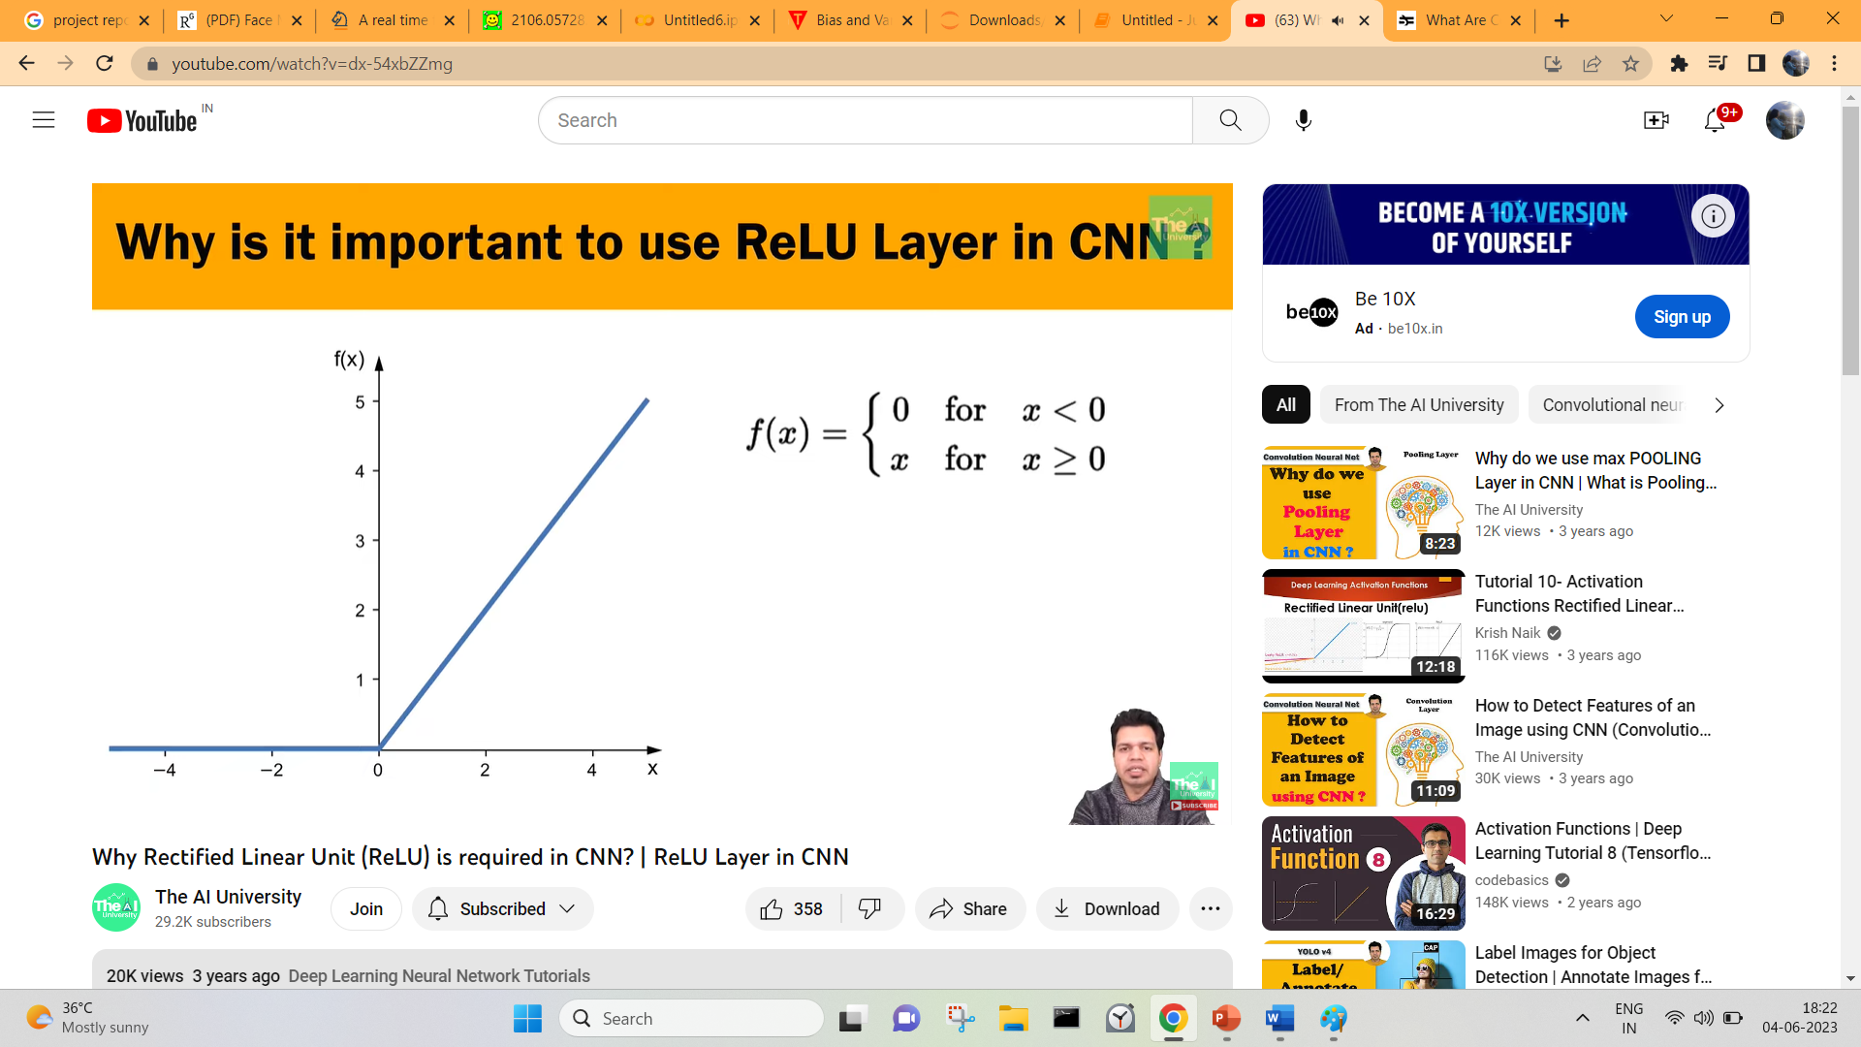

2) Rectified linear unit
Rectified Linear Unit is an activation function (which decides whether a neuron should be activated or not).
It is actually a convention to apply Relu and introduce non-linearity in model.
Images are themselves non-linear but there might be multiple objects and boundaries which may not be.
When we apply Convolution they might result in linear image & it will become a linear model.

Slide 23
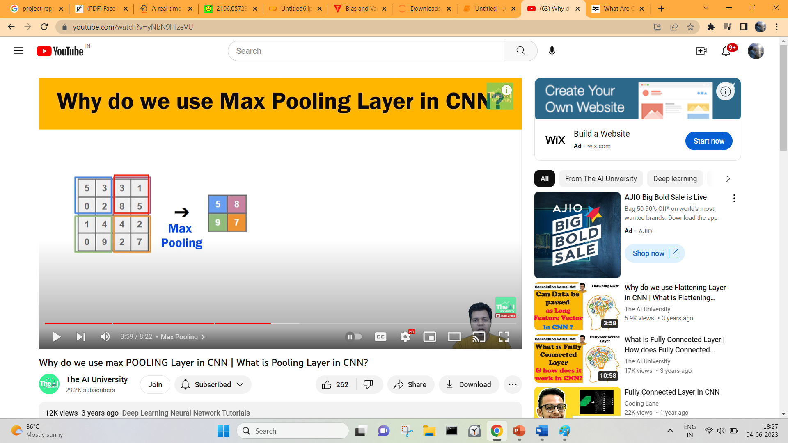
3) Max pooling layer
MaxPooling also knows as Sub-Sampling or DownSampling.
MaxPooling means extracting only the sharpest features of an image.
The sharpest features are best lower level features of an image.

Slide 24
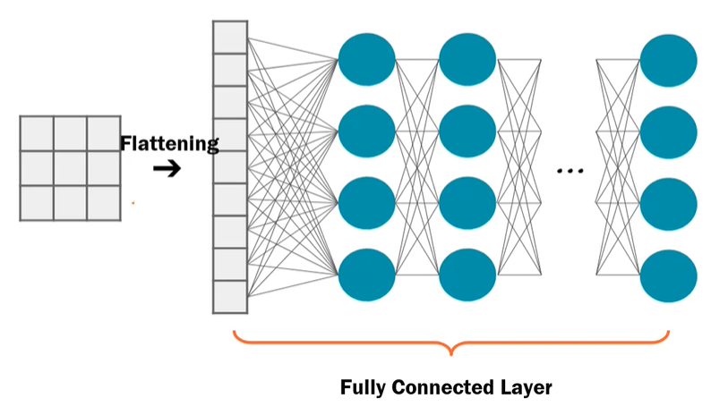
4) Flattening
It is also called Dense Layer.
Flattening converts 2d-array into 1d array. Flattening is converting output of all CNN layers
into single feature vector so that it can be used by dense layer.
ANN Classifier requires individual features .It needs feature vector into 1d
feature vector so that it can be used by ANN part of it.

Slide 25
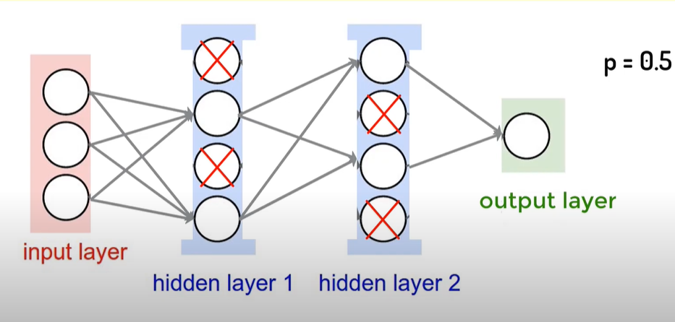
5) Dropout
Dropout layer drops out random set of Neurons or Activations setting them to zero.
Dropout also done to resolve overfitting .

Slide 26
FACE DETECTOR
After our CNN model is compiled and saved we apply a Face Detector
Here we use “Yunet” face detector. YuNet is a Convolutional Neural Network (CNN)-based face detector developed by Shiqi Yu in 2018 and open-sourced in 2019. It is a powerful lightweight model which can be loaded on many devices.
It’s said YuNet can not only reach 1000 frames per second in efficiency but also has high accuracy in performance.
YuNet has far surpassed the traditional classifiers in both detection rates and efficiency.

Slide 27
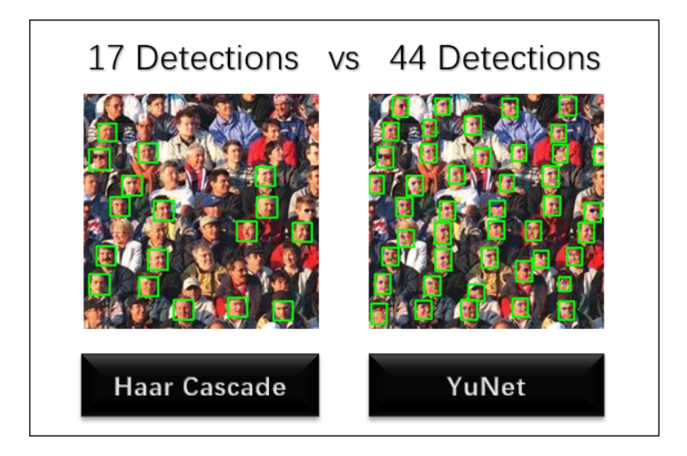

Slide 28
Summary of Model :
Now that the model is trained, it can be implemented for any image to detect the presence of mask.
The given image is first fed to the face detection model to detect all faces within the image.
Then, these faces are passed as an input to the CNN-based face mask detection model.
The model would extract hidden patterns/features from the image and thus classify the images as either “Mask” or “No Mask”

Slide 29
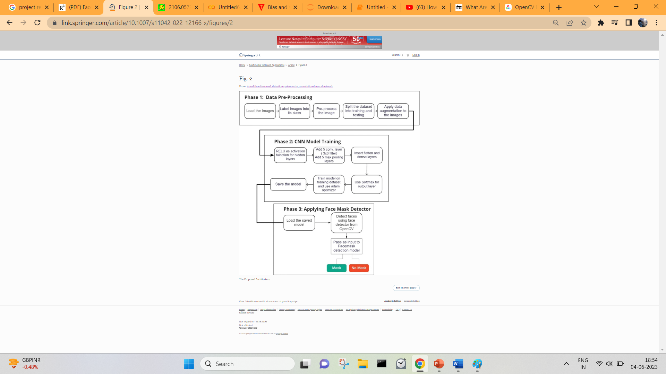

Slide 30
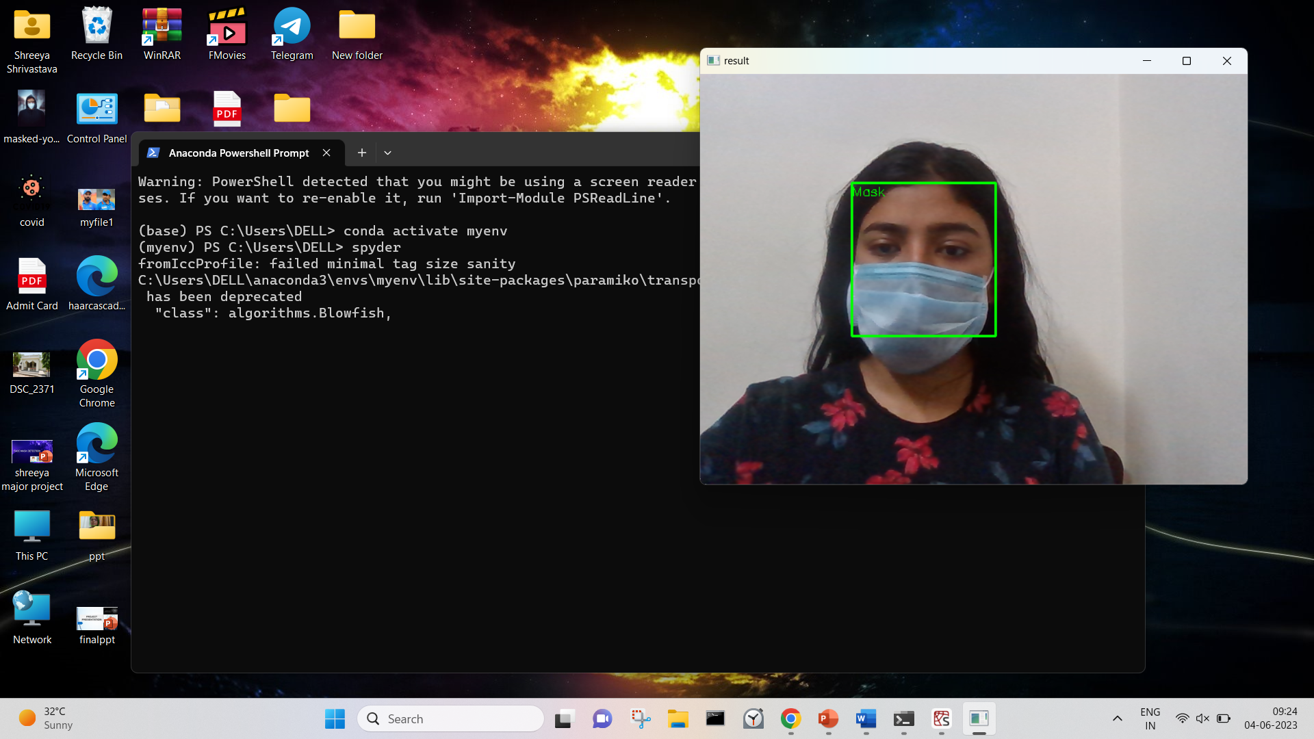
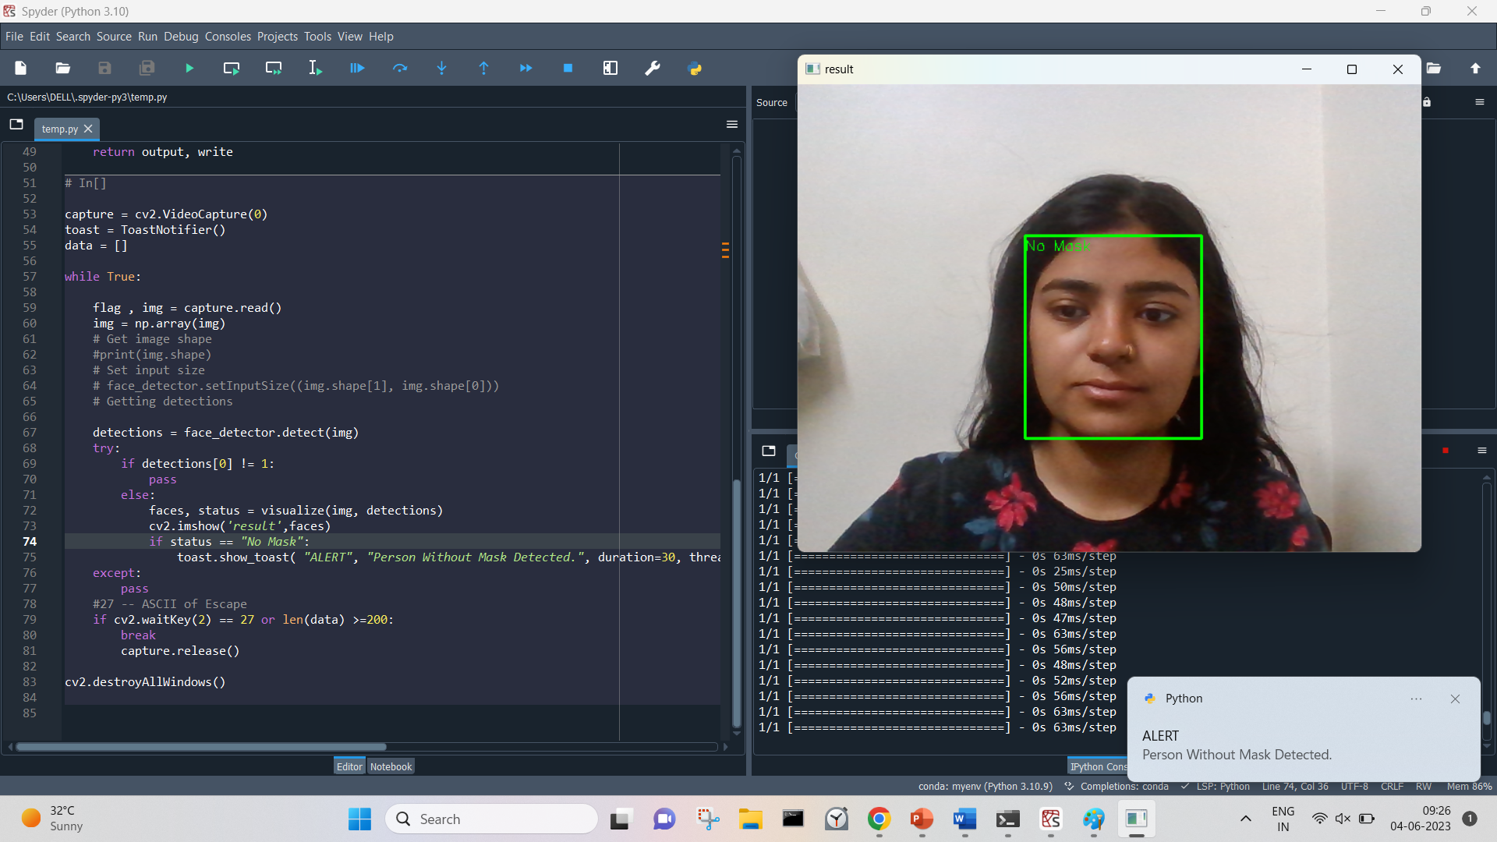
OUTPUTS :
AN ALERT NOTIFICATION IS ALSO ADDED WHEN A PERSON IS NOT WEARING A MASK.

Slide 31
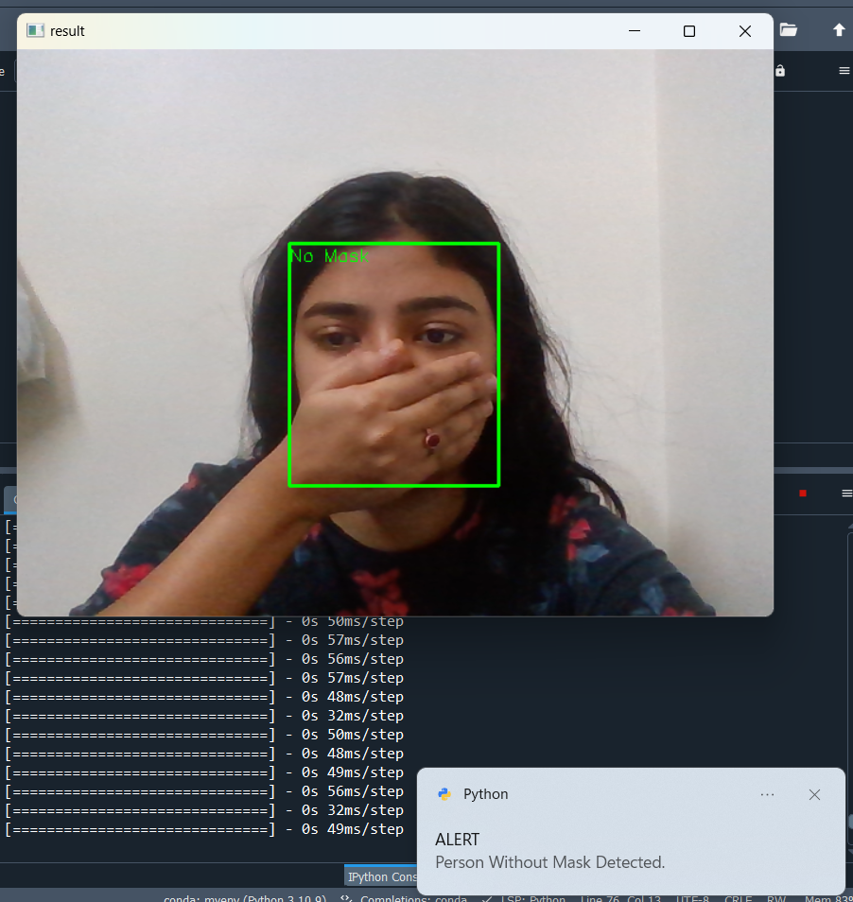
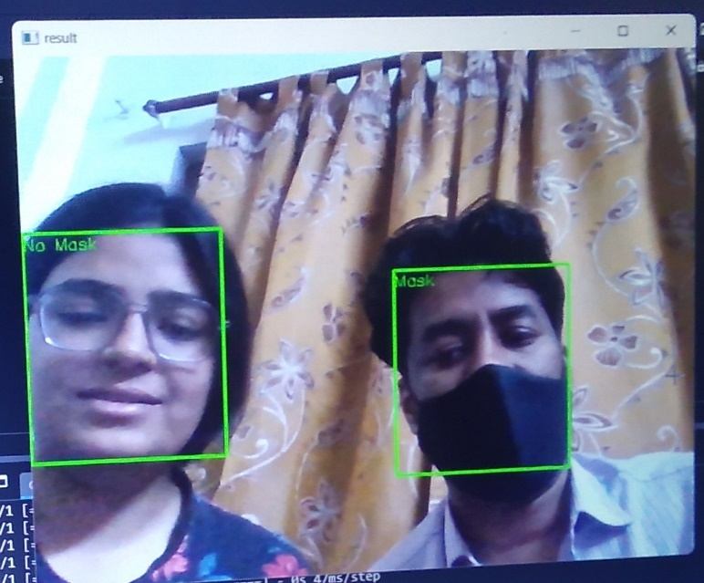

Slide 32
Importance of Face Mask Detection :
The Face Mask Detection System can be used at office premises to detect if employees are maintaining safety standards at work.
The Face Mask Detection System can also be used at public places to monitor protocols of Covid-19 & other diseases.

Slide 33
Advantages of the Model :
Intelligent Alerts.
Facial Recognition.
Camera Agnostic.
Easy Implementation.
Staff Friendly.
No New Hardware Needed.

Slide 34
Conclusion : The model can be implemented in various ways to protect from major health issues & can be brought into working as quickly as possible.

Slide 35
---Thank You---
Presented BY : Shreeya Shrivastava
0101CA211056

